Slide 1




The Impact of Weather on EPL Matches (5-Season Analysis)

Slide 2
Table of Contents
Introduction about The Project
Data Sets
Proposed KPIs
Star Schema
ETL Process
Visualization on Power BI
Conclusion
Resources

Slide 3
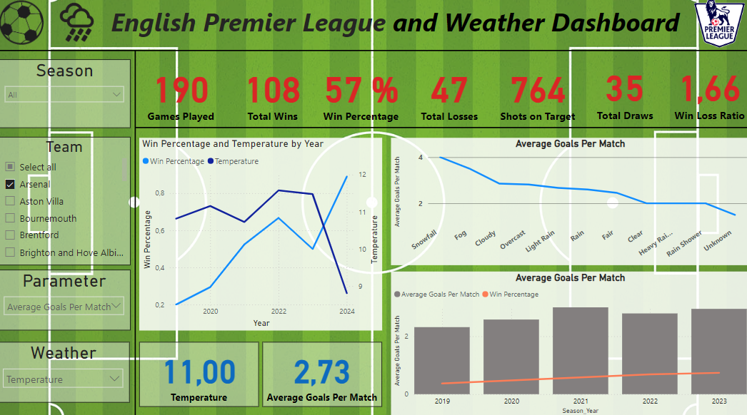
Introduction about The Project
Weather affects football performance, match outcomes, and discipline.
This project analyses five EPL seasons to study weather’s impact. Focus areas: shots, red cards, team performance and betting odds under different conditions.
Uses match statistics and weather data to uncover key trends.
Highlights the influence of temperature, rain, and other factors on the game.

Slide 4
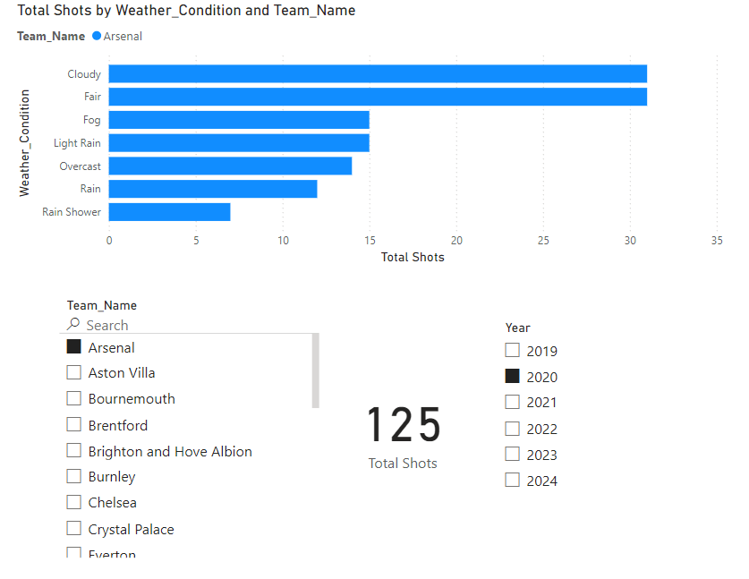
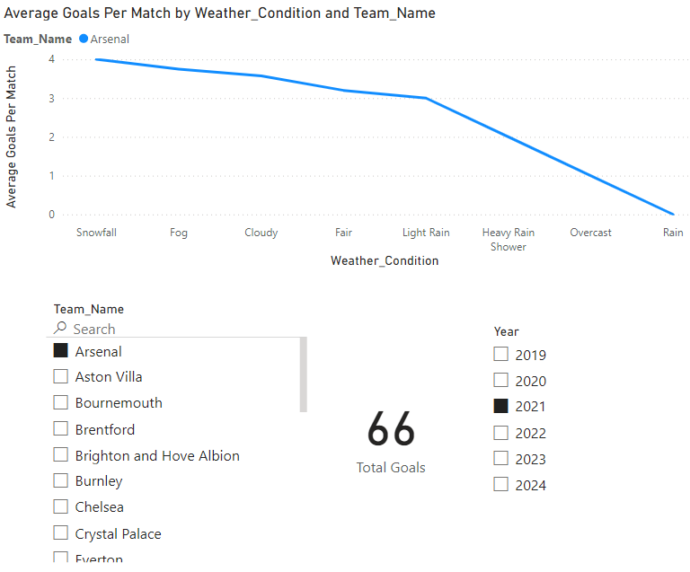
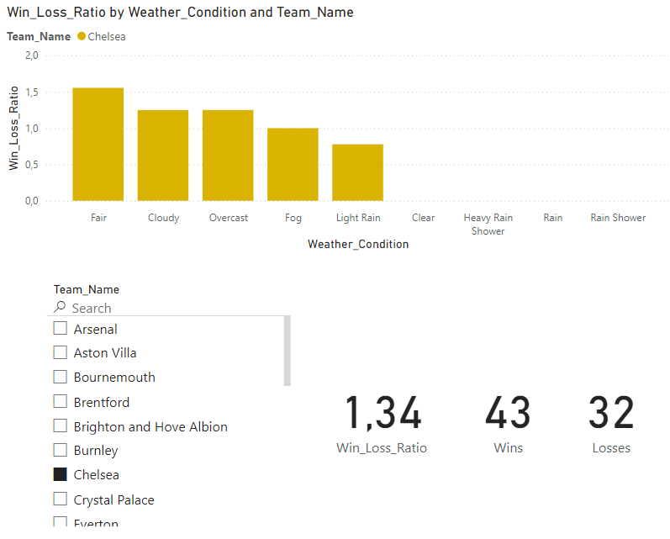
Proposed KPIs
Win/Loss ratio of teams in different weather conditions (e.g., rain, snow, high wind).
Correlation between the number of shots taken and weather conditions.
Average goals per match in varying weather conditions.
Average fouls committed and cards received under varying weather conditions.
Average betting odds for home versus away teams in adverse weather conditions.

Slide 5
Data Sets
1. https://www.football-data.co.uk/englandm.php
The English Premier League match data, including daily updates on gambling odds, is available in CSV format. This dataset provides detailed match information, such as match times, participating teams, goals, shots on target, and fouls committed.
2. https://www.premierleague.com/home
The league table, featuring daily updates on total games played, team standings, wins, and losses, is available on the official Premier League website under Premier League Tables. Leagues tables with goal scores, loss information was web scrapped.
3. https://meteostat.net/en/
Meteostat offers open access to weather and climate data, sourcing information from national weather services like NOAA and DWD. Hourly weather records include details such as temperature, wind speed, relative humidity, and overall weather conditions. The data was retrieved via API calls by python and exported in csv format.

Slide 6
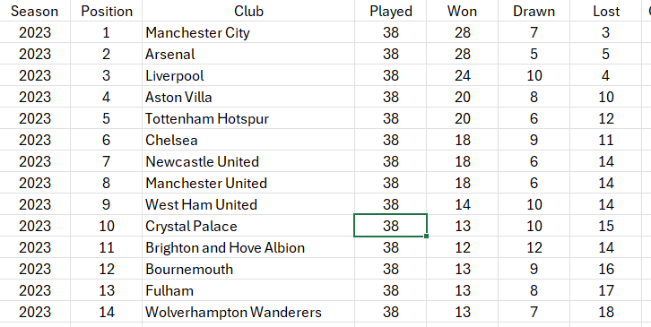
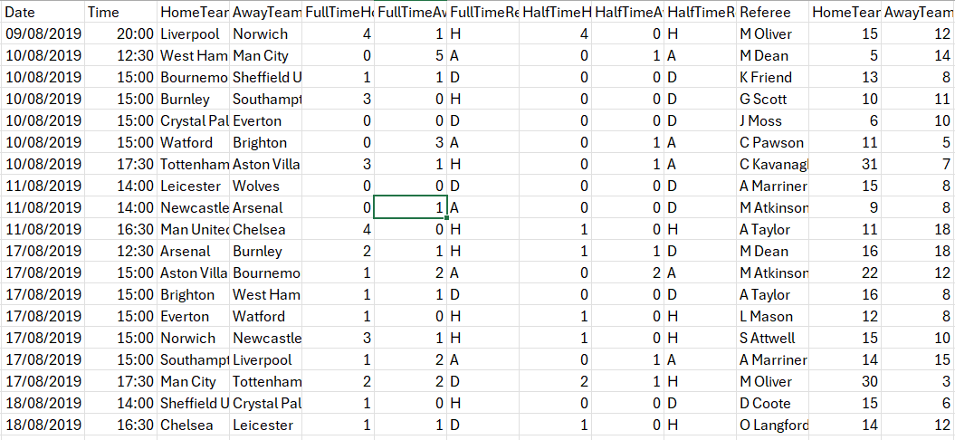
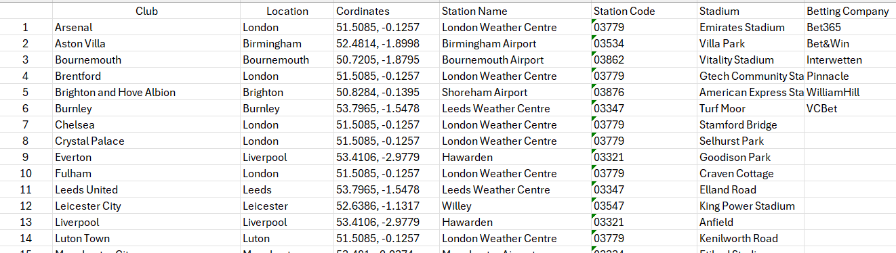
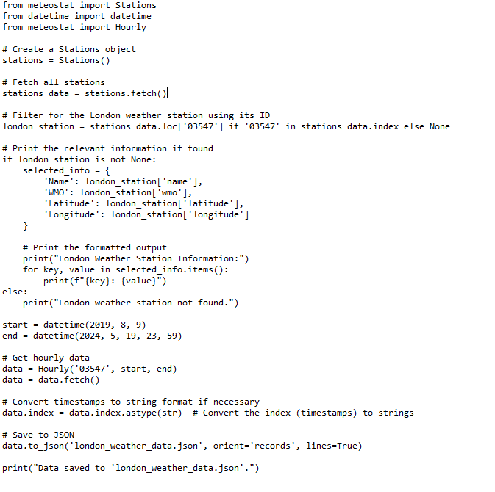
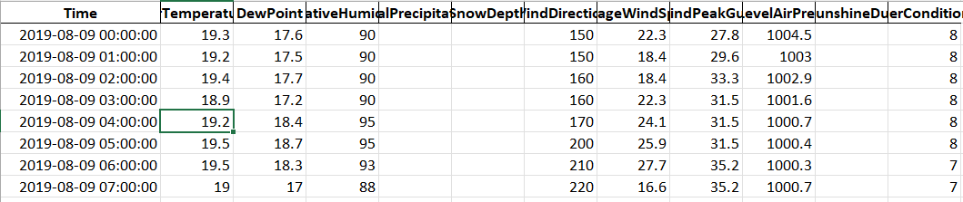
Data Sets
Football Data
5-Season csv files
1 league status excel file
1 overview excel file
Weather Data
13 csv files for different weather stations

Slide 7
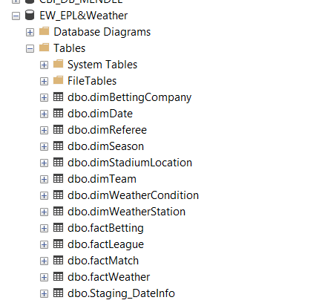
Table Structure (EW_EPL&Weather)
Dimension Tables (8 dimension tables)
dimReferee
dimBettingCompany
dimSeason
dimStadiumLocation
dimTeam
dimWeatherCondition
dimWeatherStation
dimDate
Fact Tables (4 fact tables)
facMatch
factBetting
factLeague
factWeather
Tools: MS SQL Server, SQL Server Integration Services (SSIS)

Slide 8
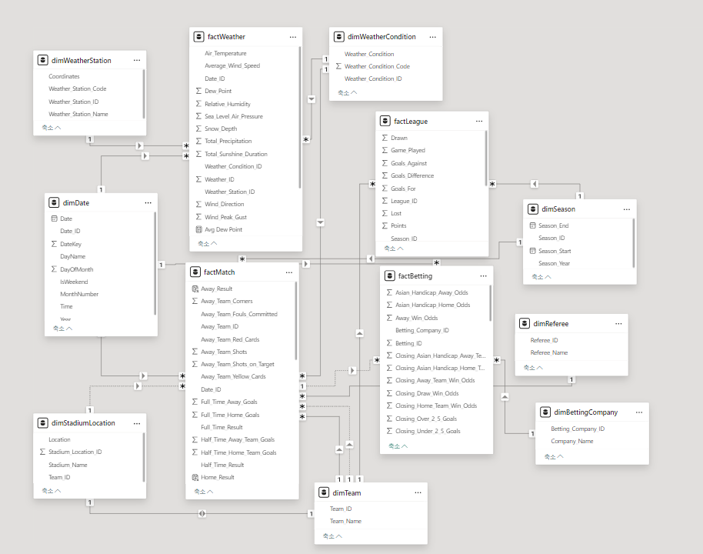
STAR Schema
Notes:
8

Slide 9
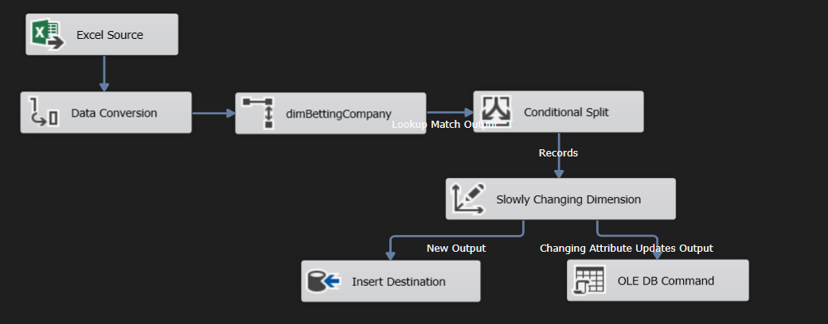
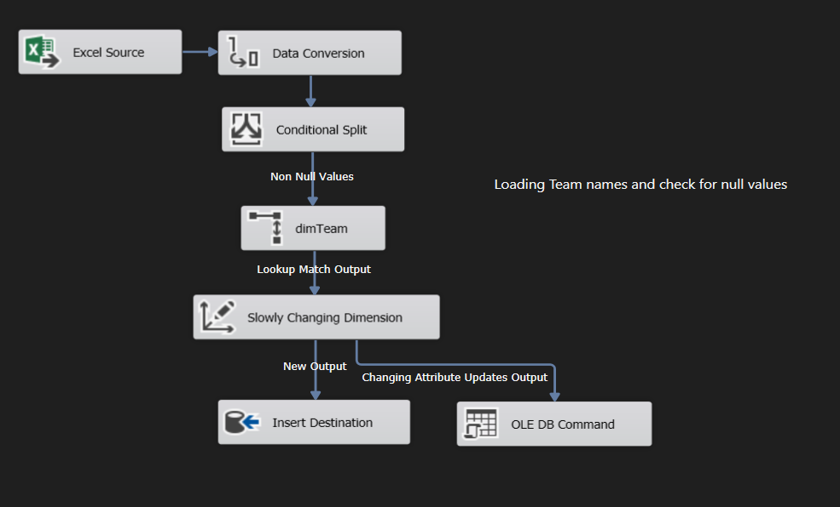
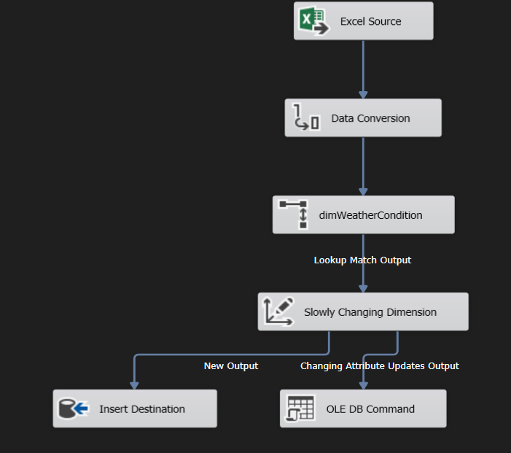
ETL Process of dimBettingCompany, dimTeam, dimWeatherCondition
Extract the source data
Convert the data type
Lookup for new data
Check for null values
Slowly Changing Dimension for changes
Load

Slide 10
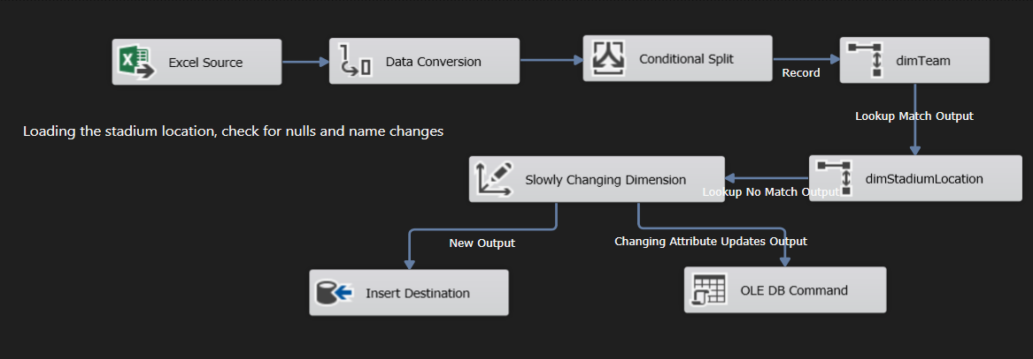
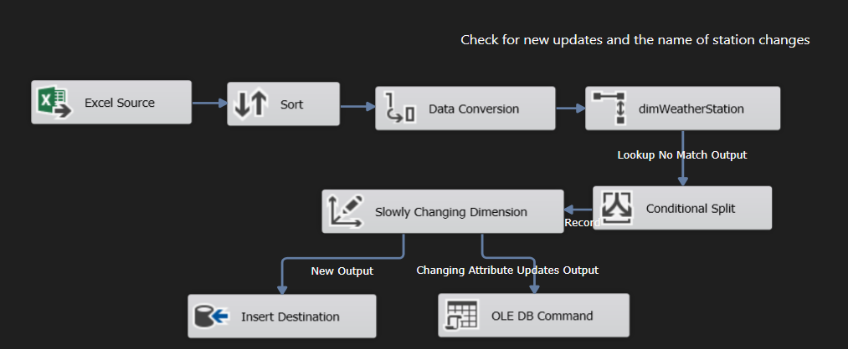
ETL Process of dimStadiumLocation, dimWeatherStation
Extract the source data
Convert the data type
Lookup for new data
Slowly Changing Dimension to update possible name (Stadium name, Weather Station name) changes
Load

Slide 11
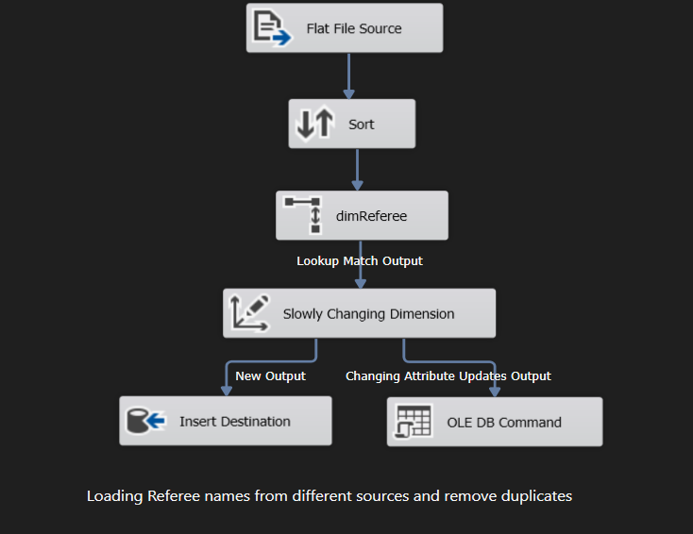
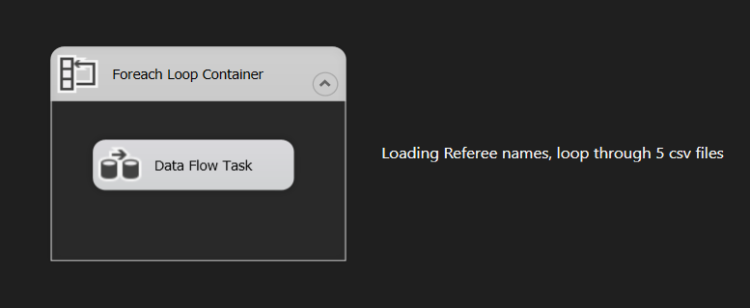
ETL Process of dimReferee
Foreach Loop Container to loop through 5 csv files
Extract the source
Sort to remove duplicates
Lookup for new data
Slowly Changing Dimension for updates
Load

Slide 12
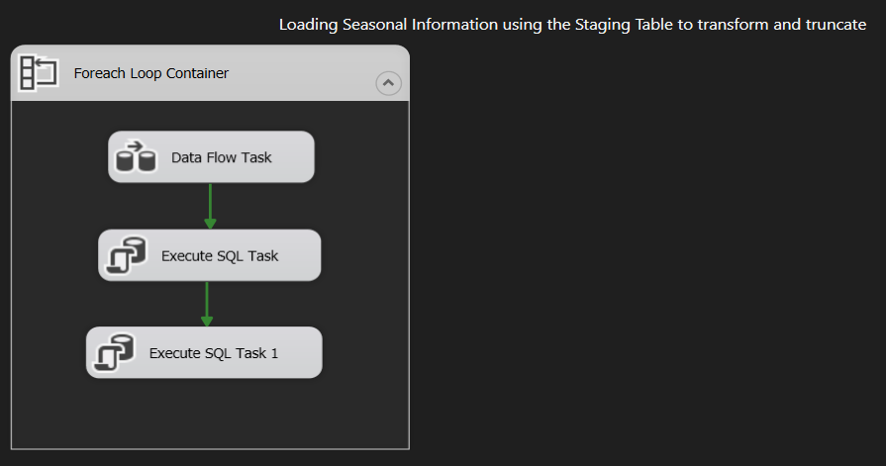
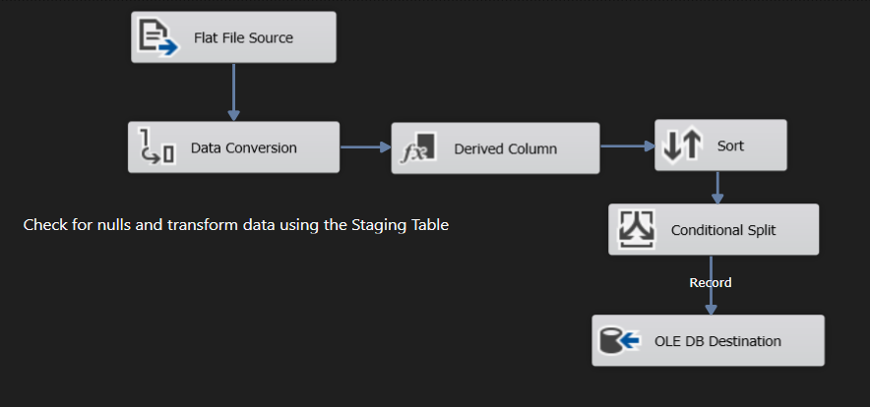
ETL Process of dimSeason
Foreach Loop Container to loop through 5 csv files
Extract the source
Derive a column ‘DateValue’, database date (DT_DBDATE)
Sort to remove duplicates
Check for null values
Load it to the Staging Table
SQL Command to read the first record and last record of the Staging Table and update it to dimSeason
09/08/2019 -> Start Date
26/07/2020 -> End Date
2019 -> Season Year
Truncate the Staging Table

Slide 13
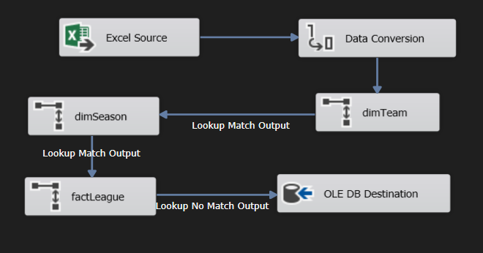
ETL Process of factLeague
Extract the source
Convert the data type
Lookup for Team_ID, Season_ID
Lookup for new data
Load

Slide 14
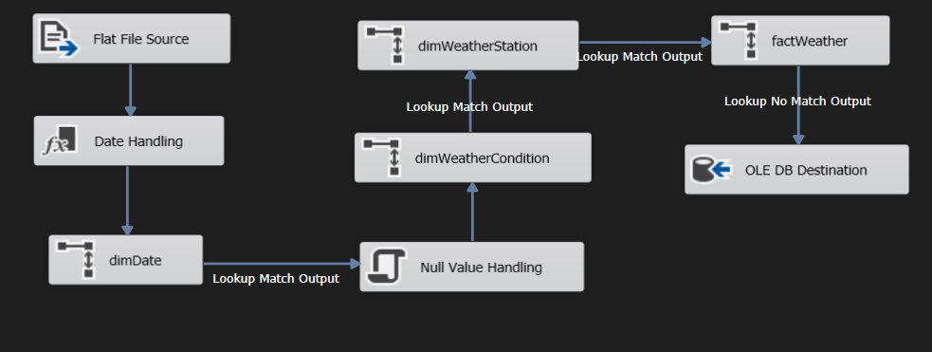
ETL Process of factWeather
Foreach Loop Container for 13 csv files
Separate Date and Time
Lookup for Date_ID
Covert null values to -9999
Lookup for Weather_Condition_ID and Weather_Station_ID
Lookup for new data using Date_ID, Weather_Condition_ID, and Weather_Station_ID
Load

Slide 15
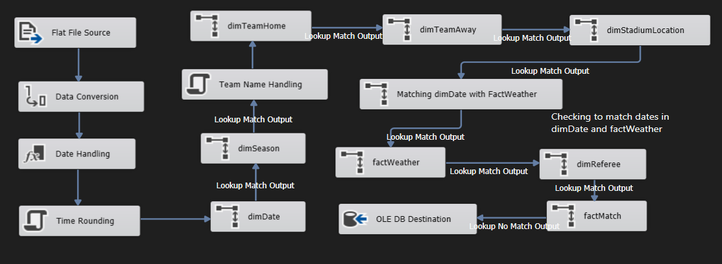
ETL Process of factMatch
Foreach Loop Container for 5 csv files
Derive columns Year, Date, Time
Roundup minutes to the nearest hour (17:05 -> 17:00)
Convert Team names (Man U -> Manchester United)
Lookup for Home_Team_ID and Away_Team_ID
Lookup for the Date_ID which matches with factWeather to get Weather_ID
Lookup for new data
Load

Slide 16
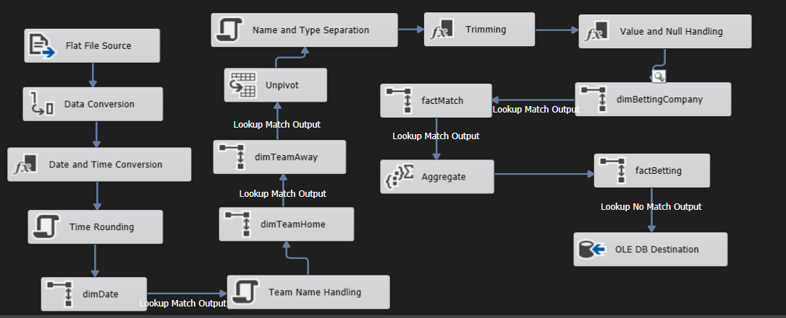
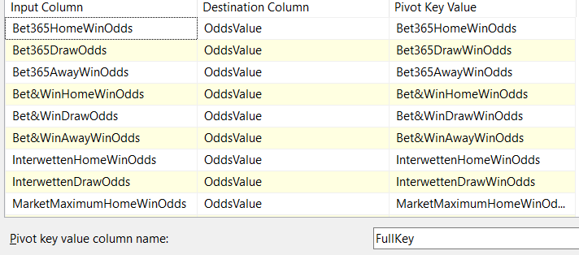
ETL Process of factBetting
Same as factMatch
Unpivot the betting columns to store Odds value
Split betting types like "Market", "Closing“, "Home“ and handle empty company values as ‘unknown’
Trim the names
Convert the values as convert null odd values as 0
Lookup tables for relevant IDs
Aggregate to Group by for IDs and Maximum to avoid multiple entries for the same match
Load

Slide 17
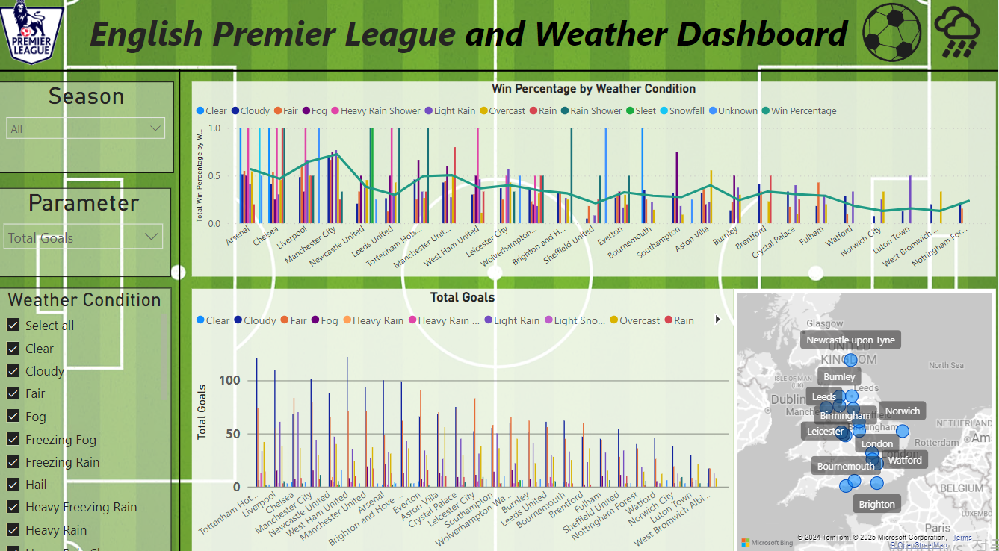
Data Visualization in PowerBI (League)
Season selection
Match related parameter
Average Goals per Match
Total Red Cards
Total Fouls
Total Goals
Total Shots on Target
Weather Condition parameter
Clear
Cloudy
Fair
etc

Slide 18
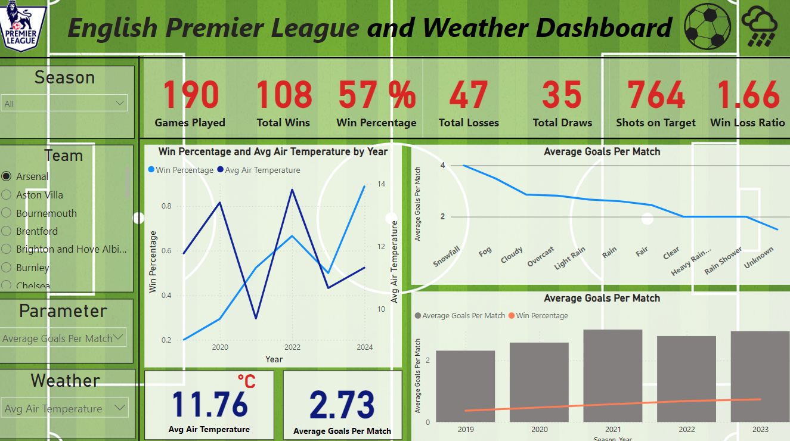
Data Visualization in PowerBI (Team)
Season selection
Match related parameter
Average Goals per Match
Total Red Cards
Total Fouls
Total Goals
Total Shots on Target
etc
Weather parameter
Average temperature
Snow Depth
Wind Speed
Total Precipitation
etc

Slide 19
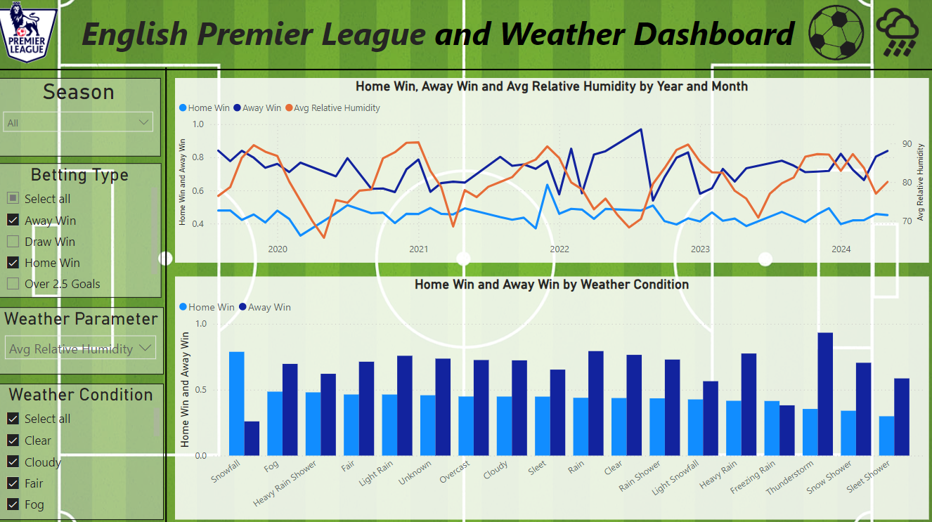
Data Visualization in PowerBI (Betting)
Season selection
Betting Type Selection
Away Win Odds
Home Win Odds
Draw Win Odds
Over 2.5 Goals Odds
Under 2.5 Goals Odds
Weather Condition parameter
Clear
Cloudy
Fair
Etc
Weather Parameter
Average temperature
Total Precipitation
Win Speed
etc

Slide 20
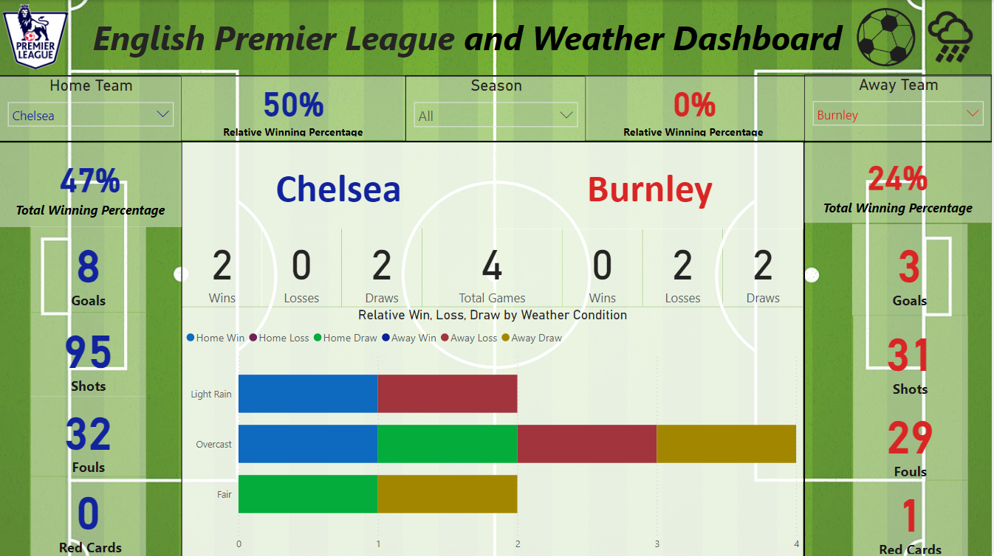
Data Visualization in PowerBI (Comparison)
Season selection
Team selection
Overall Seasonal Winning Percentages
Relative Winning Percentages (home vs away)
Relative Match Scores
Goals
Shots
Fouls
Red Cards
Relative Win, Loss, Draw by Weather Condition

Slide 21
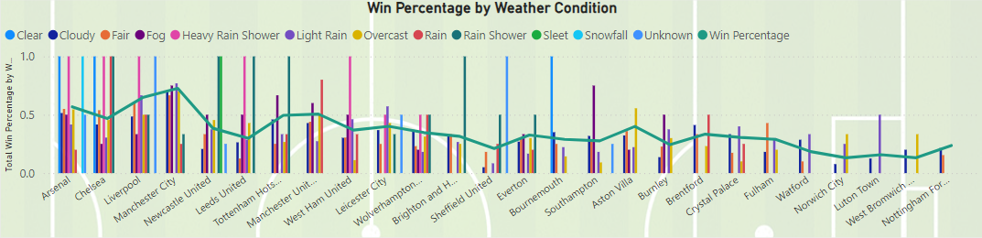
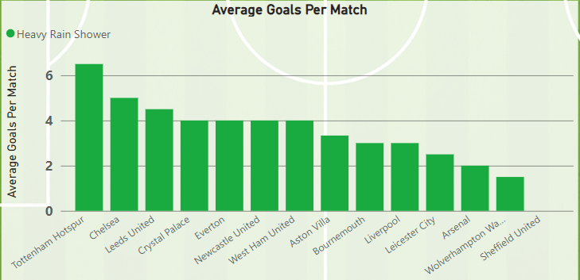
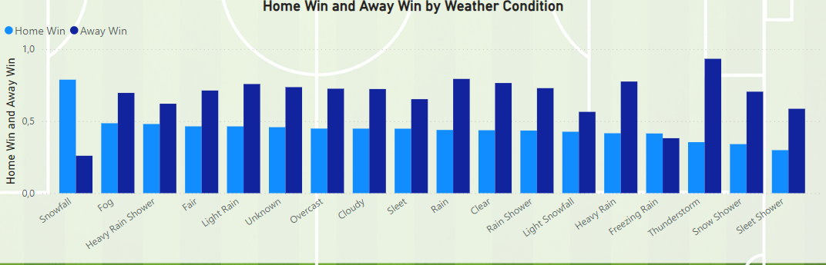
KPIs
Manchester City has maintained a winning percentage of 73% over the past five years. However, Arsenal has played under various weather conditions and tends to perform well across different weather conditions.
West Ham United took the greatest number of shots on target when it was cloudy, with 390 shots.
Tottenham Hotspur has the highest average goals per match, with 6.50, when it rains.
Brighton & Hove Albion tends to commit more fouls than other teams, with 1,998 fouls, but its winning percentage is only 32%.
Higher odds for the away team indicate a stronger belief in the home team's likelihood of winning. However, the market’s Maximum Odds for a Home Win are higher during snowy conditions.

Slide 22
Difficulties Encountered
Weather Data Collection
Many sources require paid API access.
Data for certain locations or dates may be unavailable.
Data Conversion Challenges
Date Conversion: Ensuring alignment between match times and weather data.
Granularity Issues: Weather data is recorded at different intervals, while match data varies in terms of timing and measurement units. Proper conversion is essential to maintain consistency.
Understanding of Football and Weather Data Establishing proper relationships between football match data and weather conditions requires a solid understanding of both domains to ensure accurate analysis.
Further Analysis
Needs Additional match data, including player information, would provide deeper insights.
Statistical modelling of weather and its impact on football performance remains a potential area for further exploration.

Slide 23
Thank you!

